Slide 1
SALES PERFORMANCE DASHBOARD
An interactive Power BI dashboard designed to analyze sales performance, customer behavior, and business trends through data visualization and key performance indicators (KPIs). Data analytics internship- project 4
BY: ADEYEMI RUKAYAT ADEKUNMI

Slide 2
Methodology
To build this dashboard, I first cleaned and prepared the dataset by checking for duplicates, handling missing values, correcting data types, and ensuring the data was consistent and ready for analysis. After cleaning, I carried out an exploratory data analysis (EDA) to identify patterns, trends, and key statistics. Finally, I used power BI to create an interactive dashboard with KPIs, charts, and slicers to present the findings in a clear and easy to understand format.

Slide 3
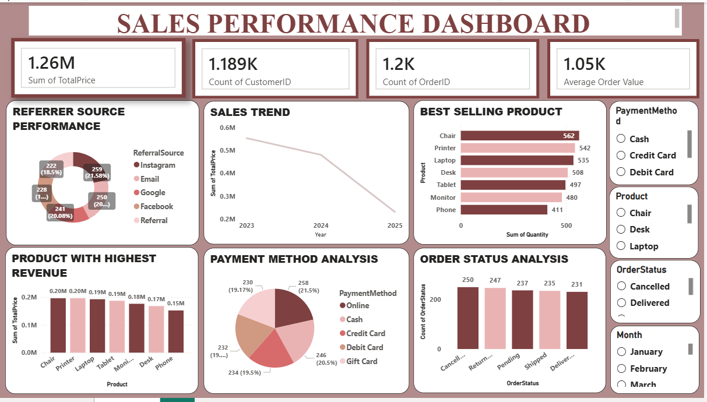
THE DASHBOARD

Slide 4
Dashboard Overview
This sales performance dashboard provides an overview of the business by tracking key metrics such as total revenue, total orders, total customers, and average order value. It also highlights sales trends, product performance, referral source performance, payment method preferences, and order status distribution to support data-driven decision-making. Overall, the business generated a total revenue of 1.26m from approximately 1.2k orders placed by about 1.19k customers, with an average order value of 1.05k.

Slide 5
KPI Summary
1.26M
1.189K
1.2K
1.05K
TOTAL REVENUE
TOTAL CUSTOMERS
TOTAL ORDERS
AVERAGE ORDER VALUE
The dashboard shows that the business recorded a total revenue of 1.26M, generated from approximately 1.2K orders by 1.19K customers. The average order value of 1.05K indicates the average amount spent per transaction.

Slide 6
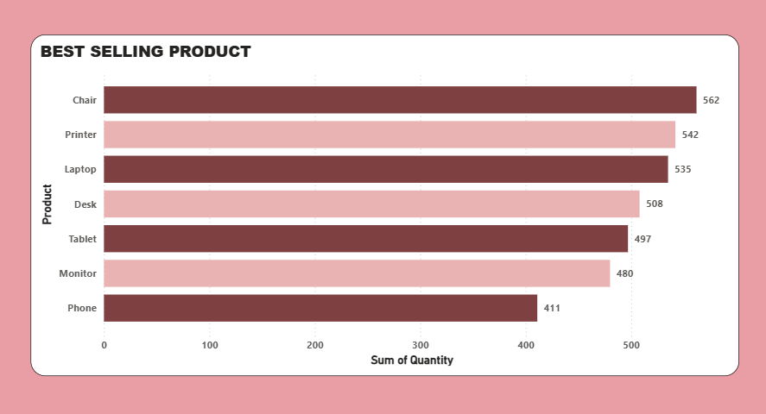
Best-Selling Product
Based on quantity sold, chair was the best-selling product with 562 units, followed by printer (542 units) and laptop (535 units). This indicates a strong customer demand for these products.

Slide 7
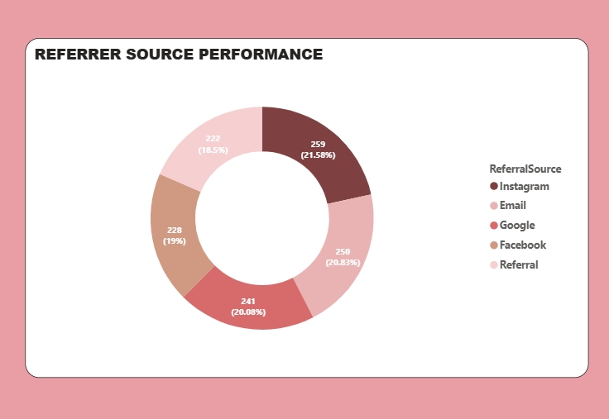
Referrer Source Performance
The referral source analysis shows that Instagram generated the highest number of referrals with 259 customers, followed by Email (250) and Google (241). The figures across all channels are relatively close, suggesting that customer acquisition is well distributed across different platforms.

Slide 8
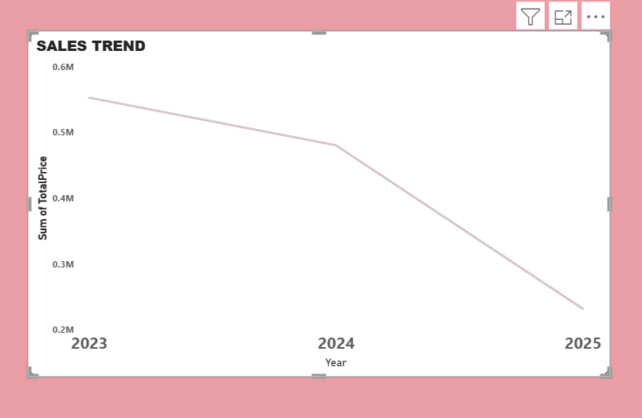
SALES TREND
The sales trend chart shows that revenue was highest in 2023, after which it gradually declined through 2024 and 2025. This downward trend suggests that the business may need to review its sales or marketing strategies to improve future performance.

Slide 9
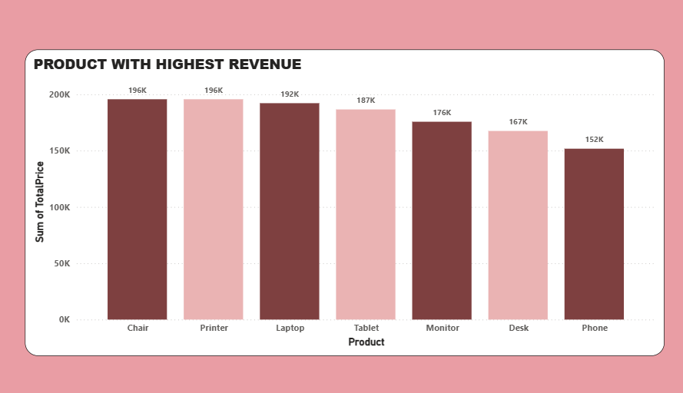
Product with Highest Revenue
The product revenue analysis reveals that chair generated the highest revenue, contributing approximately 0.20M to the total sales. This makes it the strongest-performing product in terms of financial contribution.

Slide 10
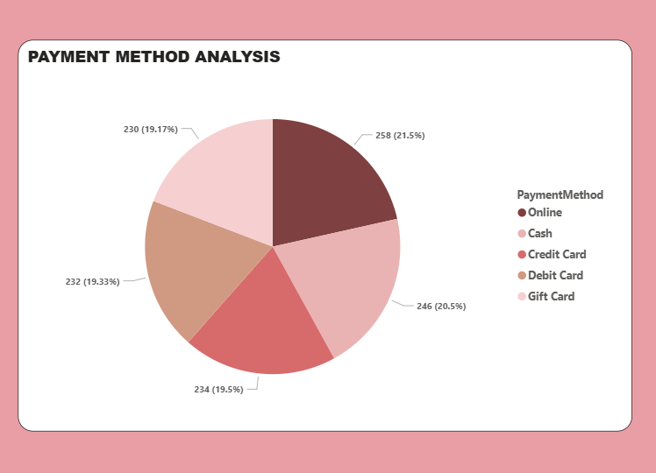
Payment Method Analysis
The payment method chart shows that customers make use of different payment options, with gift card being the most frequently used method with 258 transactions, followed by credit card with 246 transactions. The relatively balanced distribution suggests that customers appreciate having multiple payment options available.

Slide 11
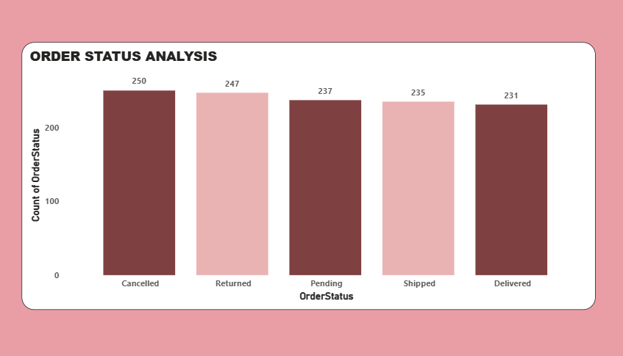
Order Status Analysis
The order status chart provides an overview of the order fulfillment process. Cancelled orders recorded the highest count with 250 orders, while delivered orders accounted for 231 orders. The close distribution across the different categories suggests that there is an opportunity to improve order processing and reduce cancellations.

Slide 12
Limitations
• The analysis was conducted using only the data provided.
• The dataset does not include additional details, such as the reasons for cancelled or returned orders.
• The insights and conclusions are limited to the information available in the dataset and may change if additional data is provided.

Slide 13
Recommendations
• Increase marketing efforts through Instagram, as it currently generates the
highest number of customer referrals.
• Ensure adequate stock is available for Chair, Printer, and Laptop, as they are the top-performing products.
• Investigate the factors contributing to the decline in sales and develop strategies to improve revenue.
• Review the order management and fulfillment process to reduce the number of cancelled orders.
• Continue providing multiple payment options to maintain customer convenience and satisfaction.

Slide 14
Conclusion
This dashboard provides a clear view of the business’s sales performance, customer behavior, and operational trends. The analysis highlights that Chair is the leading product in both sales volume and revenue generation, while Instagram is the strongest referral channel. It also reveals a downward sales trend and a relatively high number of cancelled orders, both of which present opportunities for improvement. By acting on these insights, the business can make better decisions to improve performance, strengthen customer satisfaction, and support future growth.

Slide 15
THANK YOU…

